Slide 1
Online Shoppers Intention Analysis
- By Ankit Arnav

Slide 2

Problem statement:
In an online retailing company where they are trying to find which online shopper will generate revenue by his/her online shoppers’ activity on their site.

Slide 3
Data Structure:
Administrative : Page Name
Administrative_Duration: duration of stay in that Page
Informational : Page Name
Informational_Duration: duration of stay in that Page
"ProductRelated
(no of pages visited)“: Page Name
ProductRelated_Duration (in min): duration of stay in that Page
BounceRates : "Bounce rate is a metric that measures the percentage of visitors to a website who navigate away from the site after viewing only one page. A high bounce rate indicates that visitors are not finding the content or resources they are looking for on the site."
ExitRates : "Exit rate is a metric that measures the percentage of visitors who leave a website from a specific page, rather than continuing to view other pages on the site. A high exit rate on a specific page may indicate that the page is not providing the information or resources that visitors are looking for, or that there are issues with the design or functionality of the page."

Slide 4
PageValues :"Page value is a metric that measures the average value of a webpage to a website's business. It should be used together with other metrics, as it only gives the average value of a page but it doesn't indicate how many people are actually converting or how many of them have a high or low lifetime value
SpecialDay (probability) : Special days are considered as Mother's day, Valentine's day, etc.
Month : Data taken from different months in a year
OperatingSystems : The OS used by consumers
Browser Browser used by customers
Region Regions coded as numbers
TrafficType "Traffic type in online shopping refers to the different sources
VisitorType First Time visitors(who appears first time in a date range), Returning visitors (who switch from that website/particular page and come back again in a date range)
Weekend Whether the customers visited on weekend or not
Revenue Target Column ( the Customer generated the revenue or not)

Slide 5
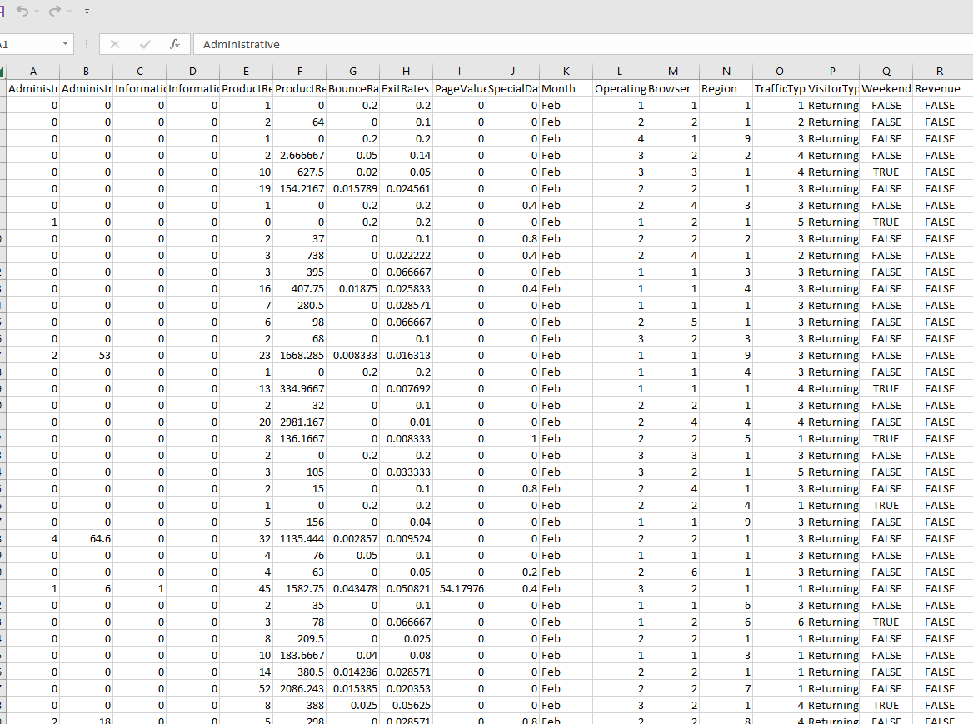
Task:
Binary Classification
Dataset Shape:
12330 entries , 18 columns
Points about Dataset:
18 variables don’t have NAs
Plenty of categorical data
No missing values
Imbalanced dataset
Lots of outliers
ML techniques:
Logistic Regression
Random Forest
Decision Tree
XG Boost

Slide 6
Data Preprocessing:
Checking for null values.
Removing duplicates.
Checking the skewness and significance of the variables.
Splitting the dataset into features and target variables.
Outlier Treatment if necessary
Checking whether dataset is imbalanced or not.
Feature Scaling the dataset using standardization as there are outliers.
Using One Hot encoder and dummy variables to get numeric data from labelled data.
Splitting the data into train set and test set.

Slide 7
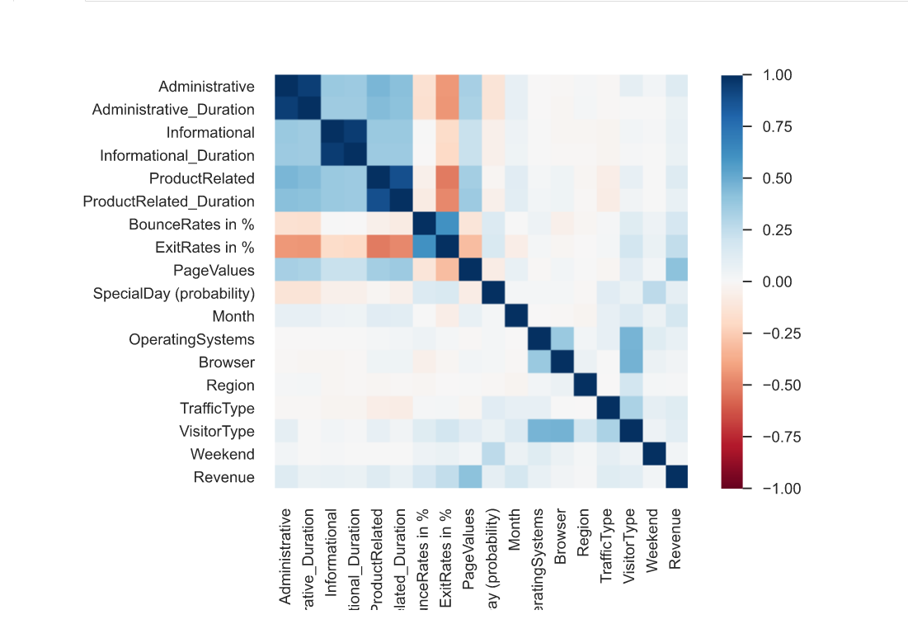
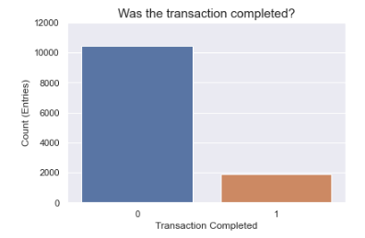
Exploratory Data Analysis
customerintention.html The given link will give a keen visualization of the dataset whether the variables are correlated , imbalances, Multi collinearity , outliers , missing values and also QQ plots against all independent and dependent variables.

Slide 8
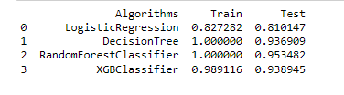
Model Building:
Since the problem statement is a classification problem we used few models including Logistic Regression , Decision tree , Random Forest ,XGBoost .
We observed that except Logistic Regression all other models gave tremendous results and out of them Random Forest was chosen as the nest fit model for the dataset and problem statement.
Although for confirmation and cross
validation we went for classification report
combining with accuracy scores.

Slide 9
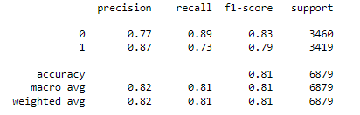
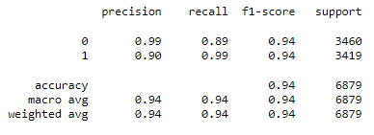
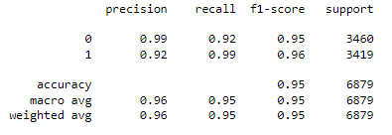
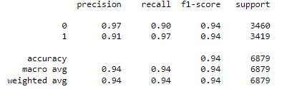


Logistic Regression | Decision Tree | Random Forest | XGBoost
Accuracy train vs test | Accuracy train vs test | Accuracy train vs test | Accuracy train vs test
So after analysing classification report and accuracy score the model appropriate for
the problem is “RANDOM FOREST” and is selected.

Slide 10
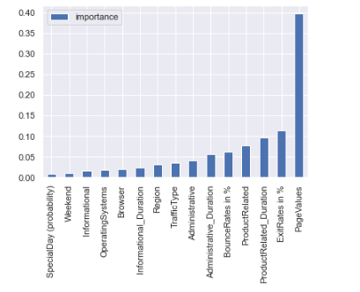
Summary:
Now our model can predict which online shoppers that visit the site will generate revenue or not.
We can also observe from the graph that the model values the PAGE VALUES as its utmost importance for predicting the same.

Slide 11
QnA
Thank You

